Slide 1
THEME- WHAT IS IT?
A theme is a universal message or truth about life.
A theme is the moral or life lesson that the character(s) and/or reader learns.
It may give a short lesson about life
“You can’t always get what you want.”

Slide 2
THEME- WHAT IS IT?
Theme is the central message expressed in a story.
A stated theme is expressed directly by the author.
An implied theme is suggested, or state indirectly through what happens to the characters.
A universal theme, or a recurring theme, is a message about life that is expressed regularly in many different cultures and time periods.
The theme is a sentence or phrase, it is NOT a word!!!
STATED Theme Example:
In Robert McNeil’s “The Trouble with Television,” the title states
the theme of the piece:
There are problems with television.

Slide 3
THEME IN MUSIC
“Tie My Hands” – Lil’ Wayne
They try to tell me keep my eyes open
My whole city under water, some people still floatin’…
Take away the football team, the basketball team,
Now all we got is me to represent New Orleans
No governor, no help from the mayor
Just a steady beatin’ heart, a wish, and a prayer
THEME:

Slide 4
THEME IN MUSIC
“Tie My Hands” – Lil’ Wayne
They try to tell me keep my eyes open
My whole city under water, some people still floatin’…
Take away the football team, the basketball team,
Now all we got is me to represent New Orleans
No governor, no help from the mayor
Just a steady beatin’ heart, a wish, and a prayer
THEME: The hopelessness and desperation of a deserted city.

Slide 5
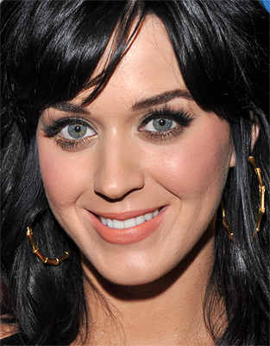
THEME IN MUSIC
“Hot N Cold” – Katy Perry
Cause you’re hot then you’re cold, you’re yes then you’re no. You’re in then you’re out, you’re up and you’re down. You’re wrong when it’s right, you’re black when it’s white. We fight, we break up. We kiss, we make up.
THEME:

Slide 6
THEME IN MUSIC
“Hot N Cold” – Katy Perry
Cause you’re hot then you’re cold, you’re yes then you’re no. You’re in then you’re out, you’re up and you’re down. You’re wrong when it’s right, you’re black when it’s white. We fight, we break up. We kiss, we make up.
THEME: Roller-coaster relationships and fickle partners are frustrating.

Slide 7
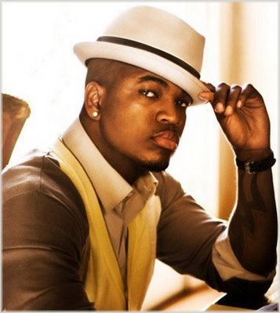
THEME IN MUSIC
“Miss Independent” – Neyo
She got her own thing, that’s why I love her
Miss Independent, oooh the way we shine
Miss Independent
Oh there’s somethin’ about
kinda woman that can do for herself
I look at her and it makes me proud
There’s somethin’ about her
THEME:

Slide 8
THEME IN MUSIC
“Miss Independent” – Neyo
She got her own thing, that’s why I love her
Miss Independent, oooh the way we shine
Miss Independent
Oh there’s somethin’ about
kinda woman that can do for herself
I look at her and it makes me proud
There’s somethin’ about her
THEME: Independent women deserve love and respect.

Slide 9
THE PROCESS
Step 1: Identify the major characters
Step 2: Identify the character(s) beginning situation
What is the character(s) thinking or doing at the beginning of the story?
Step 3: Identify the character(s) end situation
What is the character(s) thinking or doing at the end of the story?
Step 4: Ask yourselves what the character(s) learn throughout the story
Step 5: Match your answer with the multiple-choice answer it fits most closely

Slide 10
SUCCESS!!!!!
You officially know how to identify theme and have experience!

